Slide 1
OpenROAD: The Journey So Far, and the Roadmap
Andrew B. Kahng, UCSD
abk-openroad@ucsd.edu
https://theopenroadproject.org
https://github.com/The-OpenROAD-Project
Notes:
Good morning. Many thanks to Stefan and the organizing committee for the invitation to come here today -- I am very honored and excited to be here with so many who share the vision of open hardware innovation.

Slide 2
Agenda
What is OpenROAD ?
How did we get here ? (The Journey)
Where are we going ? (The Roadmap)
Notes:
Here’s the agenda. What is OpenROAD? How did we get here? (I.e., The Journey) And where are we going – i.e., The Roadmap.

Slide 3
The Crisis of Hardware Design
ASIC design in advanced nodes: barriers of Cost, Expertise, Risk
Innovators can’t evaluate PPAC metrics of their design ideas
A. Olofsson, ISPD-2018
Notes:
To explain WHAT is OpenROAD, you have to start with WHY OpenROAD.
It is simple: the crisis of hardware design, and the need to democratize access to silicon.
Today, taking ideas into silicon runs into BARRIERS of Cost, Expertise, and Risk.
[CLICK] This is from Andreas Olofsson’s keynote talk at the International Physical Design Symposium, more than five years ago. The red curve says that the cost of DESIGN is OUT OF CONTROL.
[CLICK] Innovators can’t tell how good their ideas are, in terms of hardware metrics like size-weight-and-power, or PPA. It’s just too difficult to take their ideas into silicon.

Slide 4
Design with Proprietary EDA: Need $$$, Experts
Very sophisticated tools with 1000’s of commands
Vendor focus: performance, power, area for bleeding-edge customers
20+ years of “hyperoptimization” in two main platforms (silos)
Need large teams of expert users, many manual steps
Long project schedules: tool latencies, limited licenses, …
Significant project risks
Notes:
How DO designers today transform their ideas from Verilog or VHDL into manufacturable chip layouts?
[CLICK] The commercial EDA tools that have thousands of commands, so that bleeding-edge customers can squeeze the ULTIMATE performance, power and area density out of a foundry’s technology.
[CLICK] But the tools are difficult to master. You need expert users who perform many manual steps. Runtimes are long, licenses are costly, and the industry is a duopoly -- which works against openness and interoperability. These factors compound and bring significant risk to chip design.

Slide 5
OpenROAD: June 2018 – December 2023
“Foundations and Realization of Open, Accessible Design”
Funded by U.S. DARPA as part of the Electronics Resurgence Initiative (ERI). (UCSD = prime contractor)
Mission: Democratize IC Design, Boost HW & EDA Innovation
Revitalize EDA
Contract: Deliver an Open-Source, RTL-to-GDS EDA system
24-hour, no-human-in-loop, tapeout-clean layout in FinFET nodes
Since 2020, Precision Innovations, Inc has been the key industrial developer: R&D, support, outreach
Major support from Google (+ commercial engagements)
Notes:
OpenROAD was launched in June 2018 as part of the DARPA Electronics Resurgence Initiative.
“ROAD” stands for Realization of Open, Accessible Design. UCSD is the prime contractor
[CLICK] The OpenROAD mission is to democratize IC design, and to boost both hardware and EDA innovation at scale.
Our contract is to deliver a tool that produces RTL-to-tapeout-clean GDS, in foundry FinFET nodes, in 24 hours, with no human in the loop. Oh – and in permissive open source.
[CLICK] We put together a great team of universities plus Qualcomm and Arm.
[CLICK] Since 2020, a company called Precision Innovations, Inc has driven R&D and especially the support and outreach that the project also demands.
And we’ve received major support from Google and from several commercial engagements.

Slide 6
OpenROAD: RTL-to-GDS, No Humans, 24 Hours
FOCUS: Ease of use and runtime
Directly attack the crises of design and innovation
Schedule barrier: RTL-to-GDS in 24 hours
Expertise barrier: No-human-in-loop, tapeout GDS
Cost barrier: Open source (and, runs in 24 hours)
Unleash system innovation and design innovation
Enable tool customization to system, application needs
Notes:
Unlike commercial EDA, the focus of OpenROAD is on ease of use and runtime.
[CLICK] It attacks the crisis of design AND the crisis of innovation by attacking the barriers of schedule, expertise and cost.
[CLICK] This unblocks system ideation and design space exploration – it’s friction-free, with almost zero overheads. It’s transparent and customizable.

Slide 7
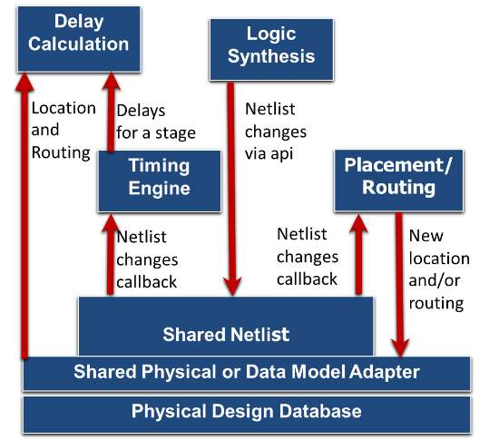
Industrial Strength Incremental Architecture: Built to Last
Further notes: link link link
Notes:
OpenROAD has the architecture of a modern EDA place-and-route tool, and it’s built to last.
This incremental Shared Netlist Architecture is the guts of commercial P&R tools since the early 2000s.
The Shared Netlist or Abstract Network Adapter enables incremental netlist modification, and communicates with Synthesis, Placement, CTS, Optimization, Routing, and the Timer. This picture shows how if Synthesis
[CLICK] changes the netlist, then [[i.e., we might be looking at the “life cycle” of a gate-sizing step]] there is a
[CLICK] callback that place-and-route is listening for – Then, if P&R changes the location or the routing,
[CLICK]this is updated via the Shared Physical or Data Model Adapter which handles physical information such as location or routed shapes.
The timer is listening
[CLICK] for a netlist change, and to update delays and slews, the delay calculation uses the
[CLICK] updated location and routing information.
[CLICK]
This architecture is what enables thousands of sizing or incremental moves per second – which is the heart of modern physical synthesis and P&R.

Slide 8
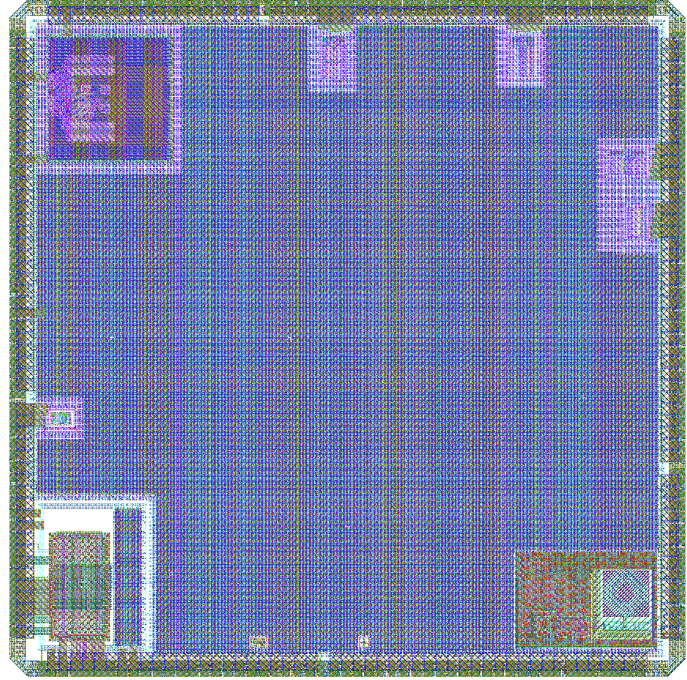
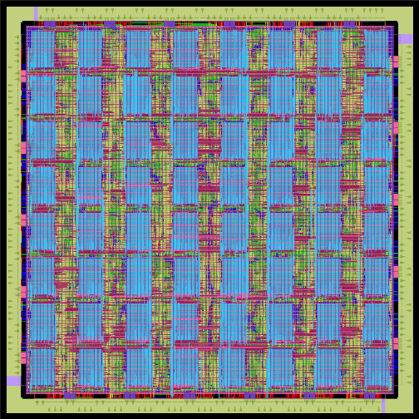
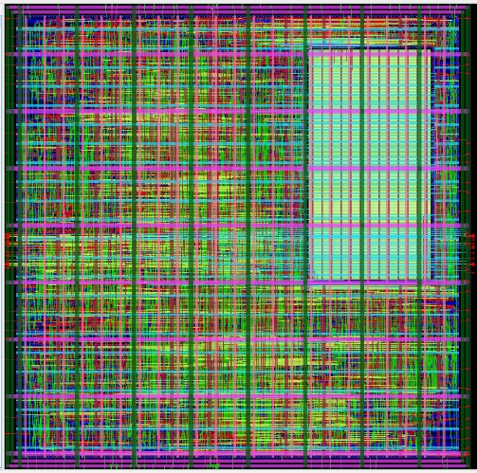
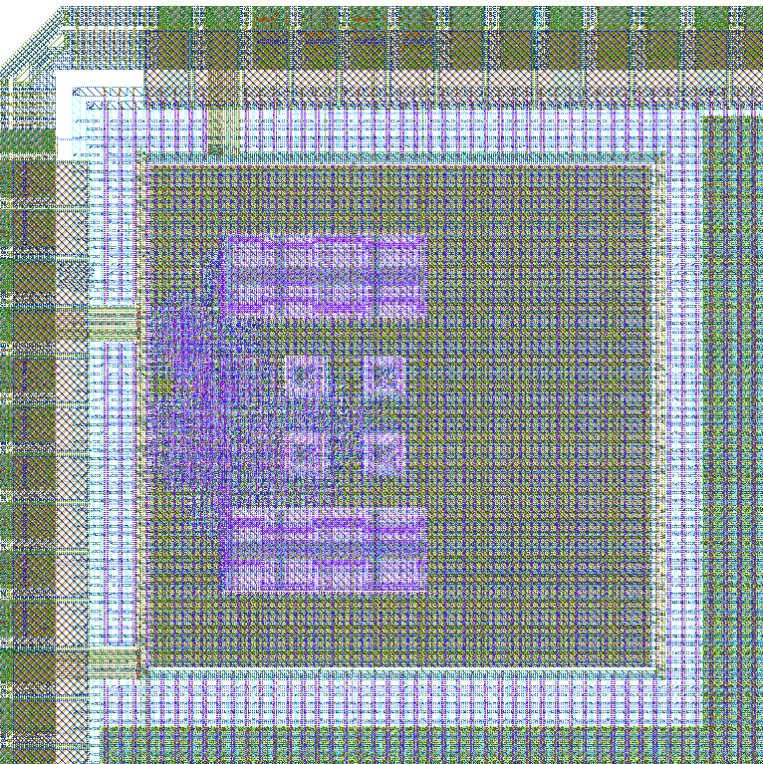
Usage in Advanced Nodes
GF55 AI platform
GF12LP AI tile
OpenTitan SoC
Army Research Labs
GF55, GF12LP
U. Michigan / FASoC GF12LP
Notes:
I still like to show these examples from a couple of years ago. On the left is a reprogrammable AI platform in GF 55 nanometer, and a reprogrammable AI computing tile in GF 12 nanometer, from the Army Research Lab -- using OpenROAD.
On the right, the FASoC team led by the University of Michigan made a GF 12 nanometer tapeout that included this OpenTitan SoC with integrated temperature sensors.
All of the physical design and timing optimization was done with OpenROAD.
[[This work includes a GF55 (3.5mm x 3.5mm, 64 8kB SRAMs, ~800k instances) reprogrammable AI platform and a GF12 (245 um x 245 um, 8kB SRAMs, ~30k instances) reprogrammable AI computing tile.]]

Slide 9
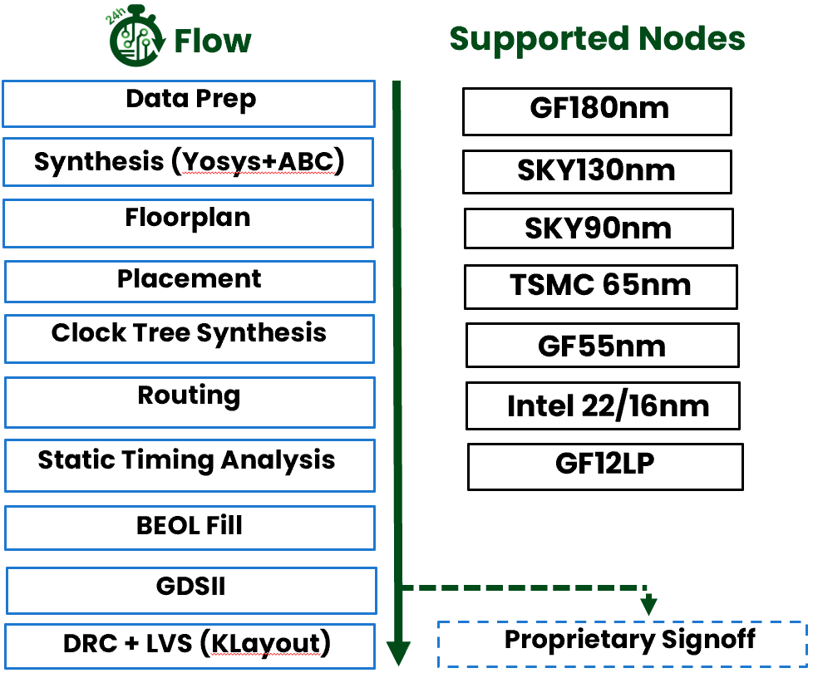
Current Status
Functionality: 600+ tapeouts at 180-12nm
Community: OpenROAD app has >18K commits from 84 contributors
Education and Workforce: from high school to graduate level, extension
Researchers
Small R&D teams, startups
Notes:
OpenROAD has a uniquely successful working partnership [CLICK] of academic researchers and EDA veterans.
[CLICK] There’s been over 600 tapeouts in foundry 180nm to 12nm. With a growing community of contributors and supporters. OpenROAD supports education and outreach on many levels – Carnegie Mellon University recently blogged about their classroom use of OpenROAD, IBM just ran a faculty development program in India …
[CLICK] OpenROAD is also the basis for research in both EDA and hardware design, and it helps small R&D teams who otherwise face too many barriers to exploring system and architecture ideas.

Slide 10
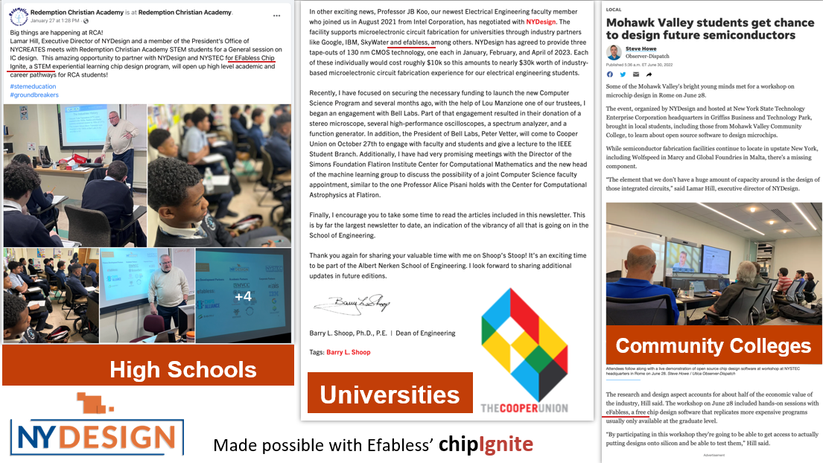
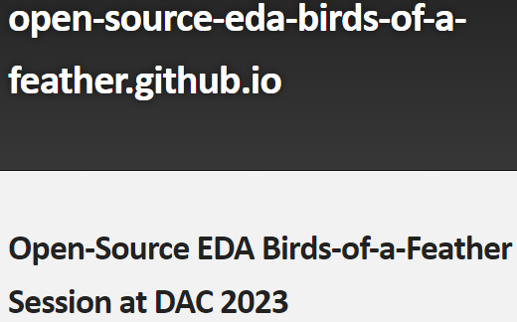
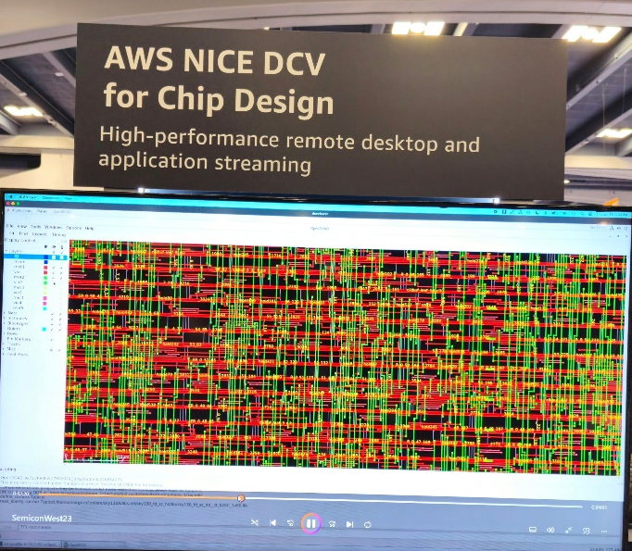
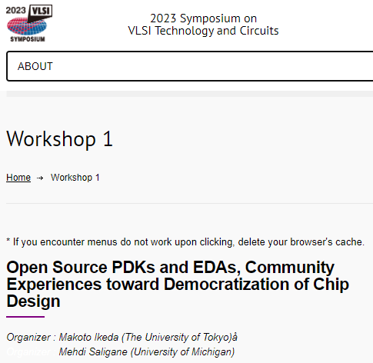
Momentum, “Virality”
Functionality: 600+ tapeouts at 180-12nm
Community: OpenROAD app has >18K commits from 81 contributors
Education and Workforce: from high school to graduate level, extension
Researchers
Small R&D teams, startups
L-R: NY Design HS, CC, University programs w/Efabless ChipIgnite; VLSI Symposium workshop in June; multiple OS EDA flows; OpenROAD demo in AWS booth at Semicon West; 4th DAC birds-of-a-feather meeting on OS EDA; OpenROAD DB and GUI extensions showing heterogeneous multi-tier post-route layout.
Notes:
This slide gives a few recent highlights. This picture shows how OpenROAD has touched students in New York State from high school through universities.
[CLICK] It was part of Workshop Number 1 at the VLSI Symposium this summer in Kyoto – and OpenROAD is also central to the IEEE Solid-State Circuits Society’s PICO program.
[CLICK] OpenROAD is inside flowrunners like Silicon Compiler and OpenLane.
[CLICK] At Semicon West in July, AWS’s booth demo showed OpenROAD running in their commercial cloud. [CLICK] There were around 90 attendees at this birds-of-a-feather meeting – the fourth in a series – at the Design Automation Conference – also in July.
[CLICK] And there is flexibility: for example, there are recent database and other extensions for fine-grain 3D heterogeneous integration layout generation – here is OpenROAD’s GUI showing multi-tier post-route layout.
[CLICK] My point is that OpenROAD has turned the corner.

Slide 11
OpenROAD Availability https://openroad.readthedocs.io/en/latest/main/README.html
The Project on GitHub
https://github.com/The-OpenROAD-Project
The Flow
Automated full flow, built using tool components that are created for automation
https://github.com/The-OpenROAD-Project/OpenROAD-flow-scripts
The Top-level Application
An integrated EDA tool focused on full automation
https://github.com/The-OpenROAD-Project/OpenROAD
More!
Documentation: https://openroad.readthedocs.io/en/latest/main/README.html
Slack: https://skywater-pdk.slack.com/archives/C0161A4A59V
OpenTapeout video: https://www.youtube.com/watch?v=wvPZREaP7E0&t=2652s
Notes:
And just in case: here are pointers to repositories on GitHub,
[CLICK] a nicely automated flow, and
[CLICK] the integrated “app”, which is the EDA tool.
[CLICK] There’s Docs and Slack discussions -- and some nice videos that introduce the tool, such as this one, online as well.

Slide 12
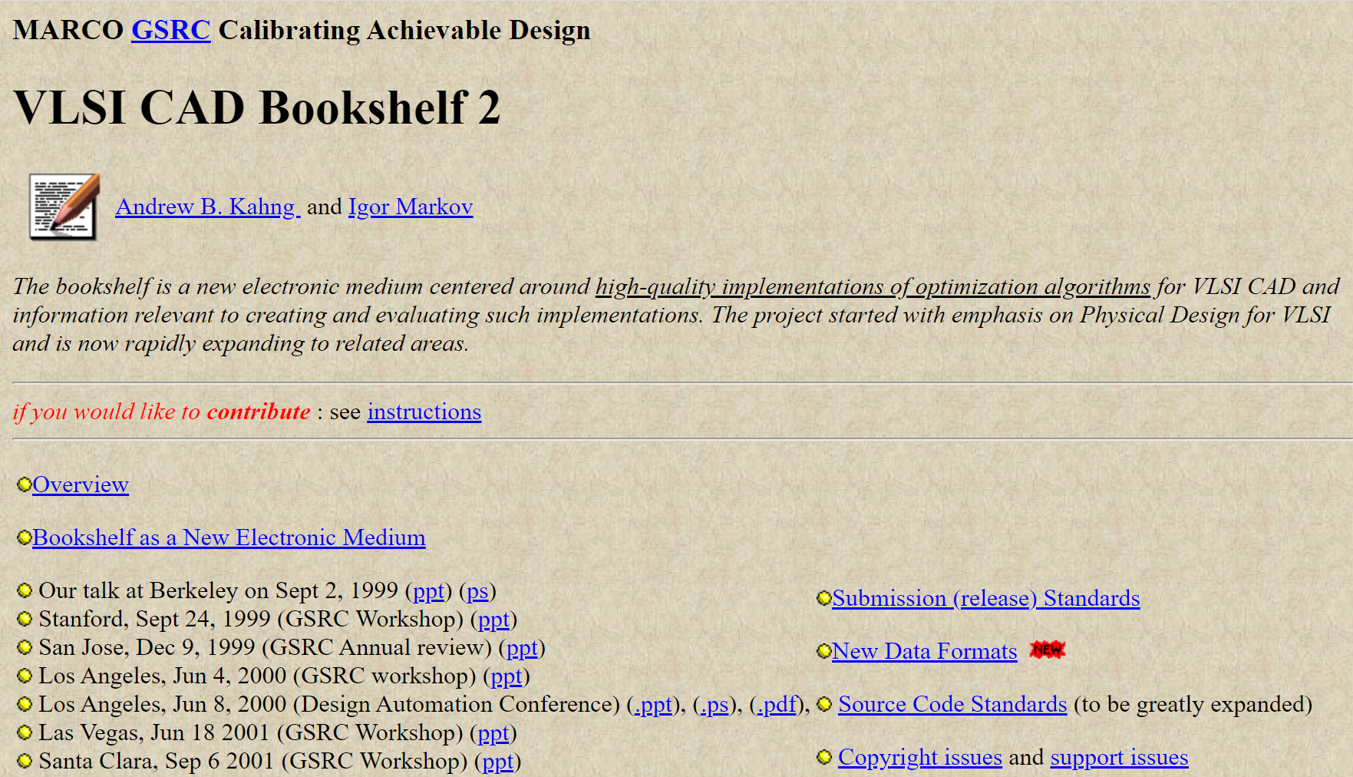
Agenda
What is OpenROAD ?
How did we get here ? (The Journey)
Where are we going ? (The Roadmap)
https://vlsicad.eecs.umich.edu/BK
Notes:
How did we get here?
For me personally, the OpenROAD journey started more than a quarter century ago [CLICK] – the Bookshelf project also tried to deliver open-source EDA with the goal of sharing knowledge and common infrastructure, to remove barriers and accelerate progress of the field. OpenROAD was informed by many lessons from the Bookshelf experience.

Slide 13
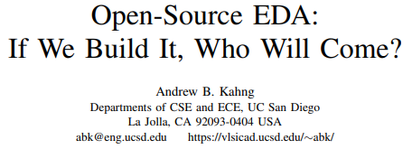
“Seeding an Ecosystem”
ERI Summit 2018: Critical mass and critical quality
ICCAD 2019: Open Source is a mirror
VLSI-SoC 2020: If we build it, who will come?
All talks are at https://vlsicad.ucsd.edu
Notes:
We knew from the start that the biggest challenge would be Critical Mass and Critical Quality. So, swing for the fences – and “seeding the Linux of EDA” – were our taglines five years ago at the very first ERI Summit in 2018
[CLICK] Some of my talks have commented on related challenges. For example, openness with source code at the research leading edge is a matter of culture and personal choice. It’s a mirror of ourselves – in a universe where academic EDA does not have the “papers with code” kinds of conventions that you see in the AI/ML or Computer Vision fields.
And, for whom are we building OpenROAD? If we build it, who will come? Who is we? What is “it”? Who will use “it” and contribute to “it”? And how will we continue beyond the project end date?
To build an ecosystem, OpenROAD knew it must serve many stakeholders: government, semi companies, strong supporters such as Google, makers, IC startups, academic researchers and students, partners, and more.
[CLICK] By the way, this talk and all my talks are posted at my lab website, and now let me spend a few minutes on the lessons highlighted by [CLICK] this question in particular …

Slide 14
If We Build It, Who Will Come? Who is “We”?
Lesson: Open-source EDA goes beyond academic research abilities
Original proposal: OpenROAD would be developed by Ph.D. students and post-docs at five universities
Separately, students and post-docs at a sixth university would be the “internal design advisors”
Vision: span product engineering, expert user testing, corporate AE-like functions
Key point: clear separation between “internal design advisors” and “tool developers” is built into OpenROAD
Deliverables such as PPA assessment and calibration must come from design advisors
Notes:
It’s perhaps THE question for open-source EDA: If we can build it, who will come?
And in my VLSI-SOC talk in 2020, I pointed out the ways in which Open-Source EDA is, truly, a “Field of Dreams”.
Some very early lessons for us were about the “WE” in “If WE build it …”
[CLICK] First Lesson: Open-source EDA goes beyond academic researcher skillsets.
[CLICK] In the case of OpenROAD --- originally, we proposed to develop the whole thing with Ph.D. students and post-docs at five universities.
[CLICK] Separately, students and post-docs at a sixth university would serve in an “internal design advisors” role – users, product engineers, and AEs all rolled together.
[CLICK] We built in this separation to ensure that when commercial tools were used to report metrics to DARPA, the students who write the tools aren’t the ones doing this. [Because there are benchmarking and reverse-engineering restrictions in commercial EDA licenses which are used throughout our universities.] So… that was the vision…

Slide 15
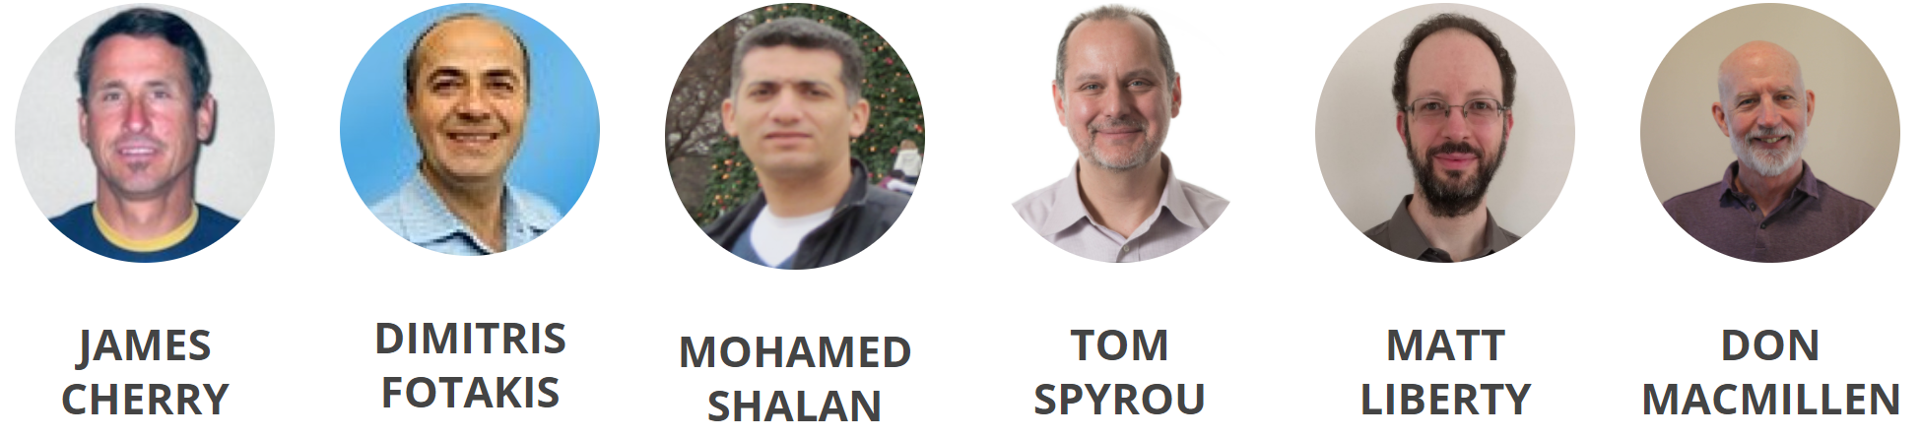
If We Build It, Who Will Come? Who is “We”?
What actually happened …
By 9 months in, need for experienced EDA architect was clear → belt-tightening and non-DARPA gift funds allowed EDA veterans to be brought into the project
Technical leadership and know-how: tool delivery, project management, infrastructure (DB, GUI, build/CI), key engines (STA, RCX)
Lesson: “We” must include professional
EDA software developers and architects.
Cho Moon
Notes:
What actually happened –
[CLICK] In OpenROAD, very soon we knew we needed a dedicated, experienced EDA architect and technical manager from outside the team.
So [CLICK] we figured out how to make this happen.
Tom Spyrou has been OpenROAD’s chief architect and technical project manager since July 2019. In industry, he previously led the teams that delivered OpenAccess, PrimeTime, Quartus and other very successful products. James Cherry was with us from the start – he wrote the Parallax timer. Matt Liberty has been full-time since January 2020. There’s 200 years of EDA industry experience on this slide --- tool delivery, project management, infrastructure, and key engines. More important, these are industry veterans who share the vision of open-source EDA as an enabler of research and how we will train up a new generation of EDA technologists.
[CLICK] So the Lesson: “We” has to include professional EDA software developers and architects.
And I’m very happy to say that [CLICK] Dr. Cho Moon joined Precision Innovations and OpenROAD last month, coming from a 30-plus year career in EDA.
And food for thought: How big is the supply of Tom Spyrous and Cho Moons, relative to the demand of open-source EDA?

Slide 16
Skills and Mindset
Strongest contributors have software skills and the right mindset
E.g., undergraduate and graduate students from CS backgrounds, in other countries (!)
Coached by EDA veterans
Obtain thesis topics, publications along the way
ICCAD-2020
Notes:
We also learned a lot about skills and mindset.
[CLICK] The strongest contributors will have software skills AND the right mindset. Some of OpenROAD’s strongest developers have been undergraduate and graduate students from outside the U.S.
They have interest in EDA, and are willing to be coached by industry veterans – and they have gotten thesis topics and publications along the way.
Our observation here is that physical design and EDA understanding is easier to grow than software development maturity.
[CLICK] This is the ICCAD-2020 paper where students from Brazil documented their experiences as developers on four separate tools within OpenROAD: global routing, clock tree synthesis, IO placement, and tapcell insertion.
[It was three undergraduates from Porto Alegre who brought up the first version of our FastRoute global router – and two of them now work full-time for Precision Innovations and the OpenROAD project.]

Slide 17
“We” Must Also Include the Right Users
Open-source EDA is still EDA
There has never been a successful EDA tool that hasn’t had an amazing AE and power user behind it
“we’re still in taxicab mode with our key beta customer”
Mainstream tool user attitude: file bug, wait for fix
Passive, problem-reporting
Power user / AE attitude: find fixes and workarounds, and package these up for R&D (developers)
Active, problem-solving
OpenROAD team has a design services / tapeout consultant
Notes:
The “WE” who builds open-source EDA must also include the right USERS (who really are partners).
Because ultimately, [CLICK] Open-Source EDA is still EDA.
[CLICK] And no EDA tool in history has succeeded without intensive “taxicab mode” support delivered by field AEs to key “beta customer” power users.
[CLICK] A mainstream user files bugs and waits for fixes.
[CLICK] A power user finds fixes and workarounds, and brings these to R&D – basically, a problem-solver rather than a problem-reporter.
In OpenROAD, we had to prove our GF12 tapeout capability in our second year. So we hired we an experienced design services consultant to help make sure we hit this milestone – and he is still with the project. We need more designers to drive the tool forward.

Slide 18
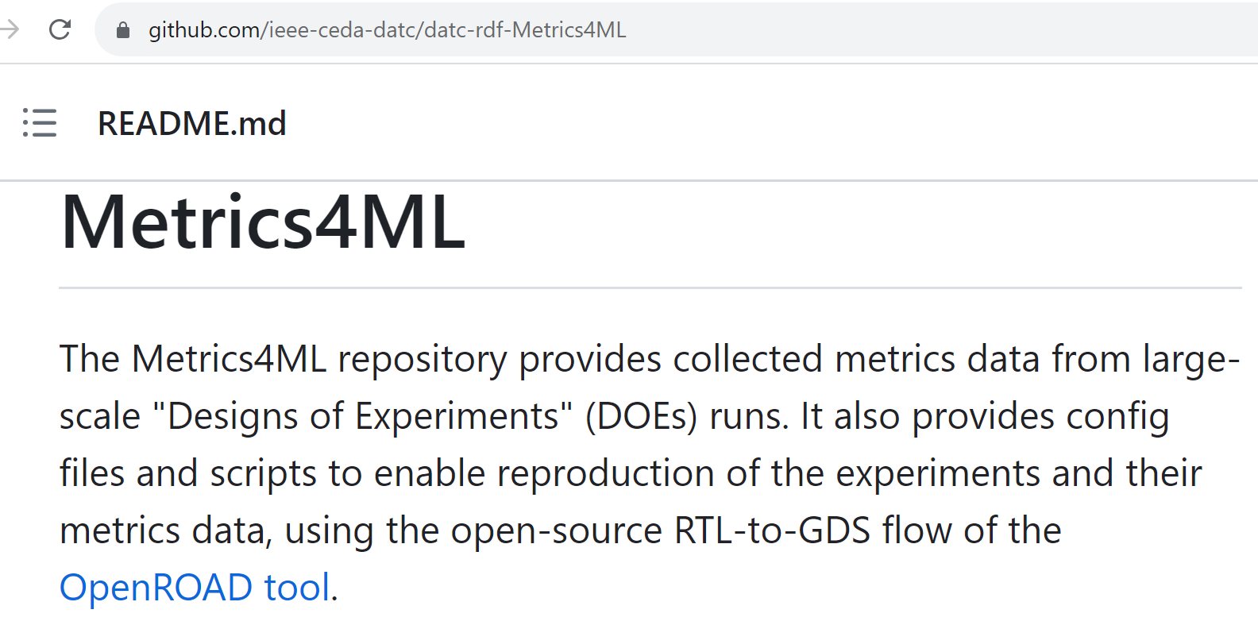
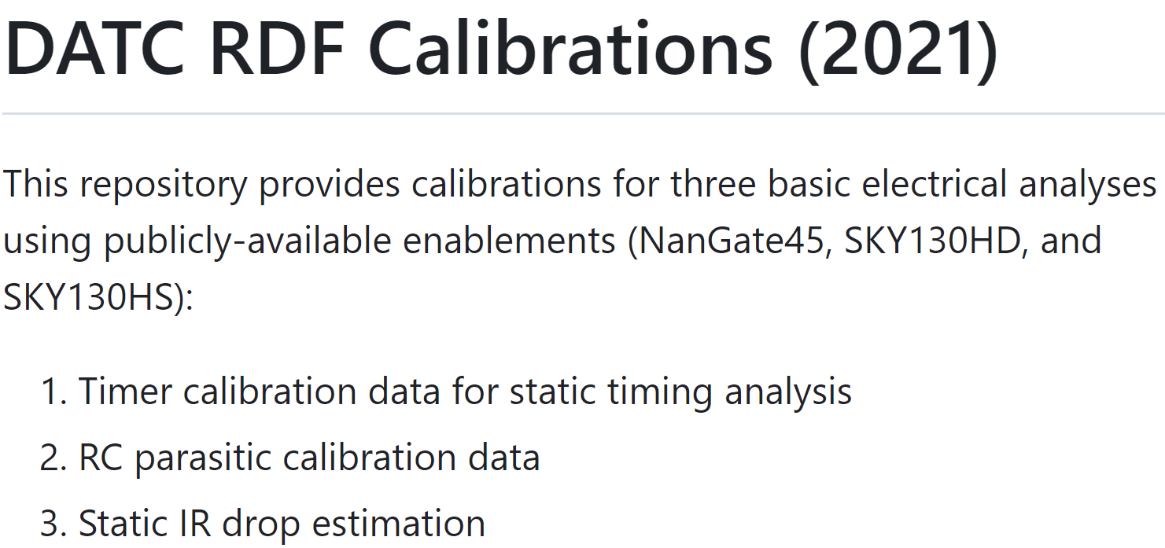
If We Build It, Who Will Come? Who is “Who”?
Who will use open-source EDA in the future?
Original vision: Users will make enhancements, pull requests …
What we found: This is a very rare type of user !
(Greatly outnumbered by the “want poor-man’s Innovus” crowd)
On the other hand
Good news #1: the Open Hardware community is very engaged and supportive
Good news #2: Academic EDA researchers increasingly see the value of open-source foundations, transparent baselines
Notes:
Next, there is the question of WHO: Who will use Open-Source EDA in the future?
Here, we started off with a wrong picture.
[CLICK] Originally, we imagined that Open-Source EDA would be a kind of Utopia where users would read the code, make enhancements and pull requests – so, the availability of source code would fundamentally unleash a new form of users’ engagement with EDA tools.
[CLICK] But really, such users are very rare. At first, many folks who contacted us were basically hoping for a poor-man’s Innovus -- they didn’t understand the thousands of years of professional R&D needed for that, and how it wasn’t a reasonable expectation.
[CLICK] On the other hand, the open hardware community is very supportive, certainly from the technical standpoint (folks like Google or IBM OpenPower or small chip companies) – but more and more from a financial standpoint as well.
[CLICK] Academic EDA researchers also see the benefit of a robust backplane for research and technology transfer to industry. For example, over the past five years, OpenROAD has become a key part of the IEEE Council on EDA’s activities to provide open research foundations: Calibrations, Metrics4ML, the RDF research flow, use of OpenDB as a “RosettaStone”, and so on.

Slide 19
“Not Research As Usual”
An academic research project, delivering tapeout-clean layout generation for commercial FinFET nodes in permissive open source, per contract with the U.S. Government
→ expectations, names, “signoff”, …
“Not Research As Usual”
First ERI Summit, July 2018
Notes:
And, in our journey we learned a lot about “not research as usual”.
Many challenges come from being an academic project that by contract must deliver tapeout-clean layout generation in commercial FinFET nodes, via permissive open source.
These are some of our early project announcements – and they hint at some issues that had to be navigated: For example, our Tcl command names and timing reports needed to stay clear of industry copyrights.
[CLICK] And we pre-emptively addressed many issues as well. This “And More” slide is from the OpenROAD presentation at the first ERI Summit – when we submitted the proposal, we had commitments from Parallax Software to open-source its timer, and donations of two commercial tools’ source code bases, and permission to use an EDA company’s established Tcl naming conventions. So: “not research as usual”.

Slide 20
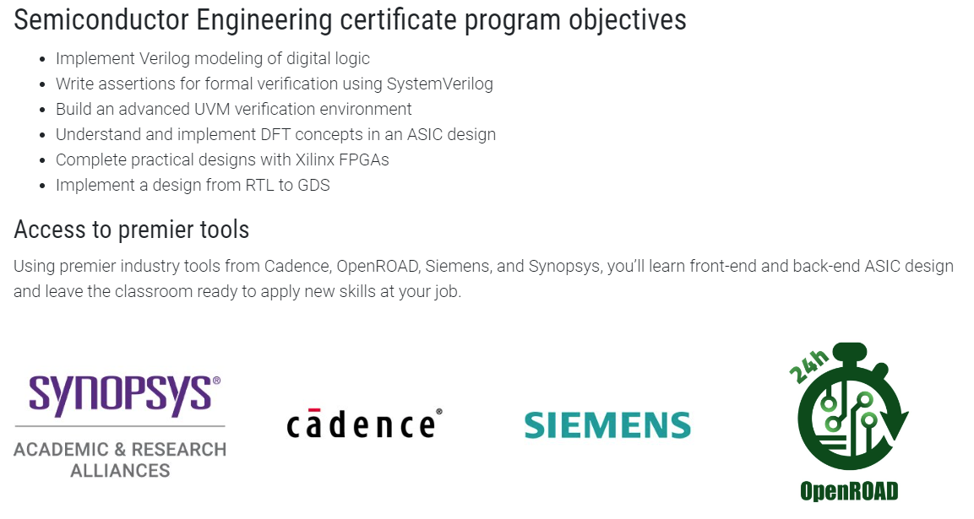
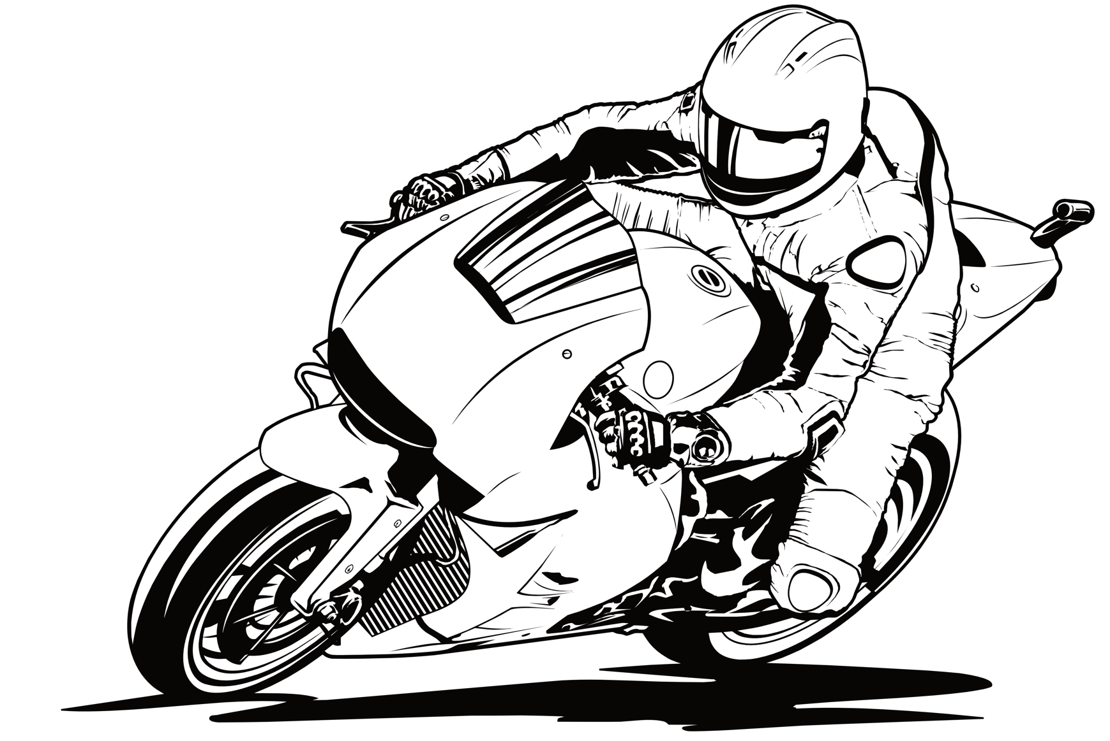
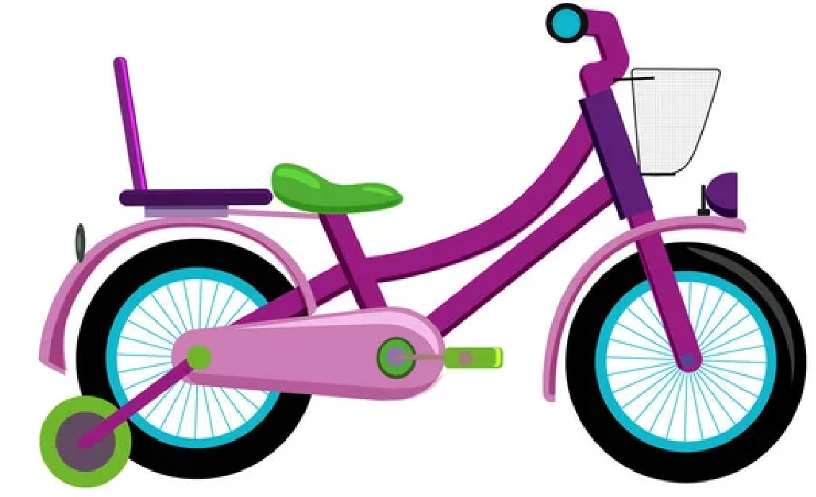
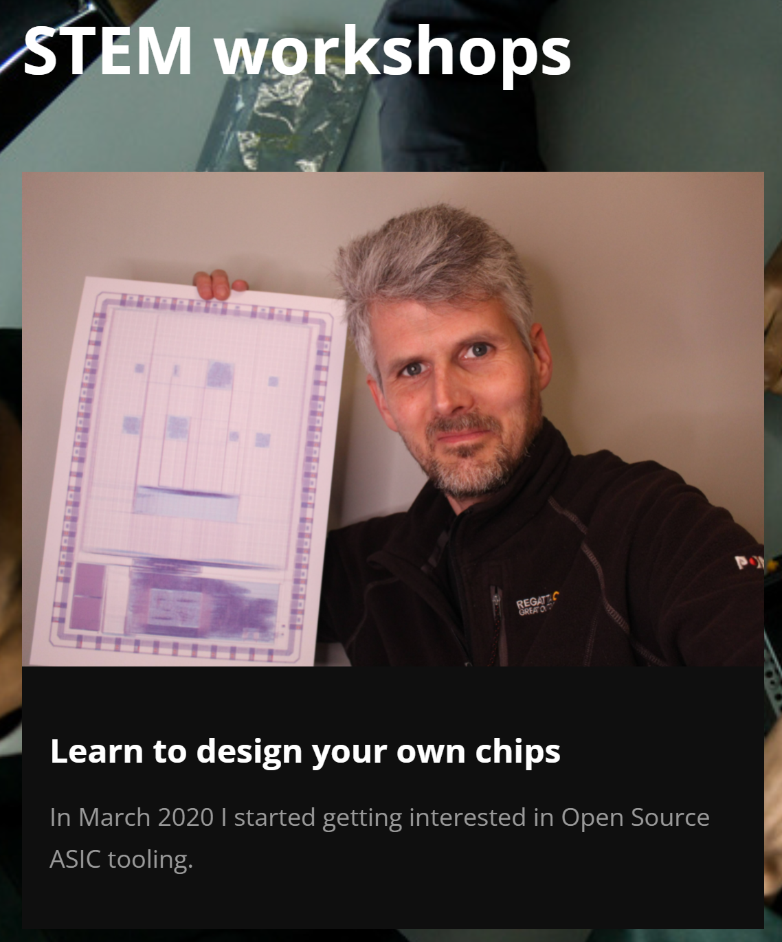
And More Dimensions: The Next Generation
Help with curriculum development, sharing, mentoring !
before
Notes:
Our journey has had many other dimensions. OpenROAD is in conversations about Workforce Development, from the middle-school pipeline to upskilling an older worker. It can open the STEM funnel earlier, without NDAs and license servers. It’s a better “on-ramp”: you start with training wheels and dirt bikes before you start riding MotoGP.
[CLICK] These are pictures from UC Santa Cruz Extension, education and training programs in India, and a Google Site that was created by two high school teachers in California, with OpenROAD support.
VIT Lab. Object Automation.
IBM OpenPOWER. MicroWatt

Slide 21
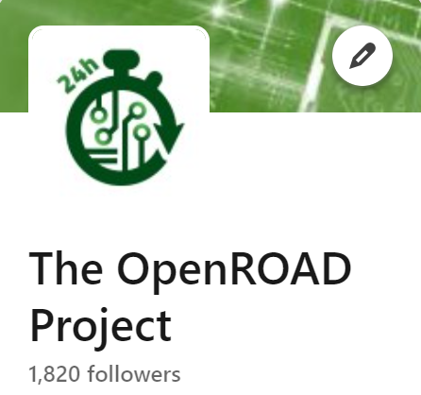
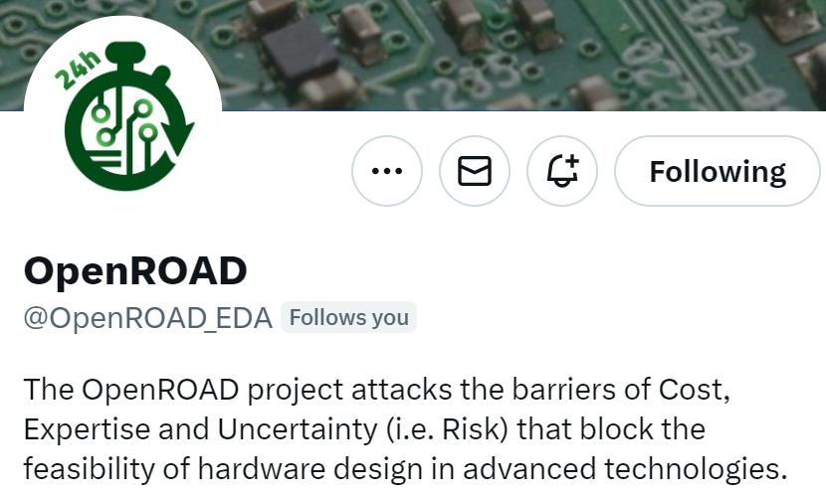
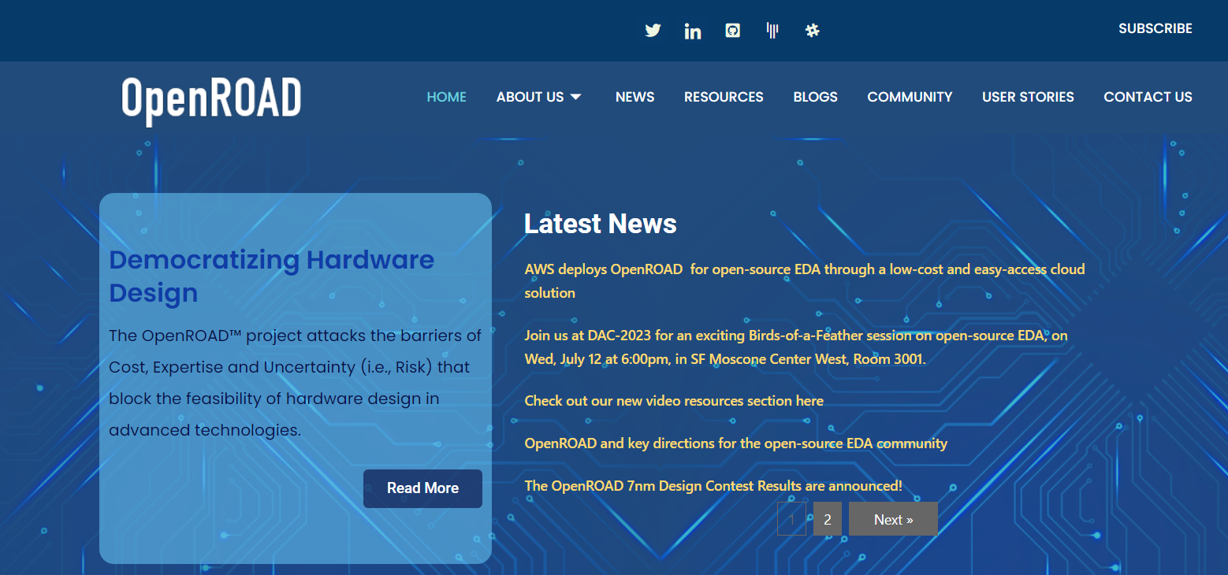
And More Dimensions: Community
Join the community !
Novice to Expert
Applications: Trust, 3DIC, AI/ML, …
Notes:
Also, our community continues to grow across a wide spectrum of users and application interests. There are many channels -- please join in !

Slide 22
Agenda
What is OpenROAD ?
How did we get here ? (The Journey)
Where are we going ? (The Roadmap)
Notes:
Next: the roadmap going forward.
[2325 words]
Governance/Transition
Philosophy / Techology
GUI
ML
Train workforce. Open funnel. Serve the underserved. …

Slide 23
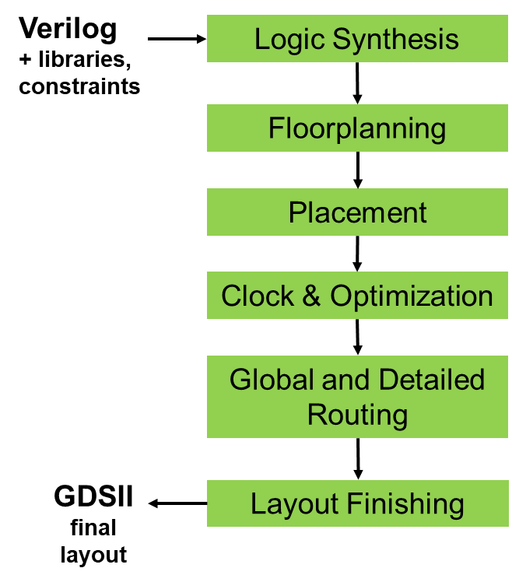
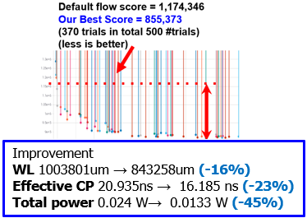
High-Level Direction: Cloud, ML
What if tool licenses are unlimited?
“COPILOT” = Cloud Optimized Physical
Implementation using OpenROAD Technology
ML challenge: predict failure and intervene
+ low-hanging fruits such as AutoTuner
Notes:
Where is OpenROAD going? Well, we work on pretty much every green box you see here, which stretches the team’s resources. But, I want to mention two overarching directions:
[CLICK] First, what is enabled by unlimited copies running at the same time? We’ve been working on “Cloud-Optimized” physical design – what we call COPILOT – and this takes us into machine learning to predict doomed subtasks and so on.
[CLICK] There is low-hanging fruit like black-box hyperparameter optimization, or AutoTuning, which finds superior flow settings that our internal design experts never imagined. This scales to thousands of cloud instances, which we’ve done in a recent project.

Slide 24
IC Design and EDA = Optimization
Optimization of Power, Performance, Area, Cost… … within design resources !
… boosted by AI / ML !
Area (Power)
OpenROAD Today
Cloud, ML, Research, GitHub, All of Us …
“Optimal”
Clock Period (1/fmax)
Notes:
When we talk about IC design or EDA tools, we are talking about OPTIMIZATION. We are always optimizing power, performance, area, or cost – within limits of licenses or people or servers. And these days we can’t talk about optimization without also talking about AI and machine learning.
[CLICK] This is a cartoon of the “hockey stick” Pareto frontier of clock period on the X axis (right is slow, left is fast), and area or power on the Y axis (up is larger). What OpenROAD achieves today is shown in BLUE. We don’t quite know where optimal [CLICK] is.
But what we DO know is that OpenROAD has the ingredients that will get us ever closer to optimality: [CLICK] Cloud, machine learning, open source – the freedom to benchmark and share data – together we can move fast.

Slide 25
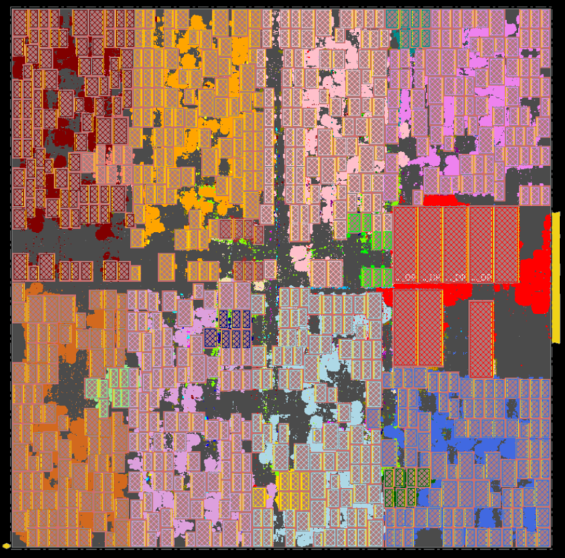
High-Level Direction: Early DSE (Arch, RTL)
Can we better explore architecture and SoC floorplan design spaces?
Hier-RTLMP: /src/mpl2
RTL and dataflow-driven, human expert-like
Notes:
The second overarching direction is to enable faster and more accurate exploration of architecture and floorplan options. Shortening the time to useful PPA feedback is incredibly valuable.
[CLICK] A new macro placer, Hierarchical RTL-MP, understands RTL hierarchy and dataflow, and it delivers very human expert-like results. This is an AI accelerator in GF 12LP with 760 macros.

Slide 26
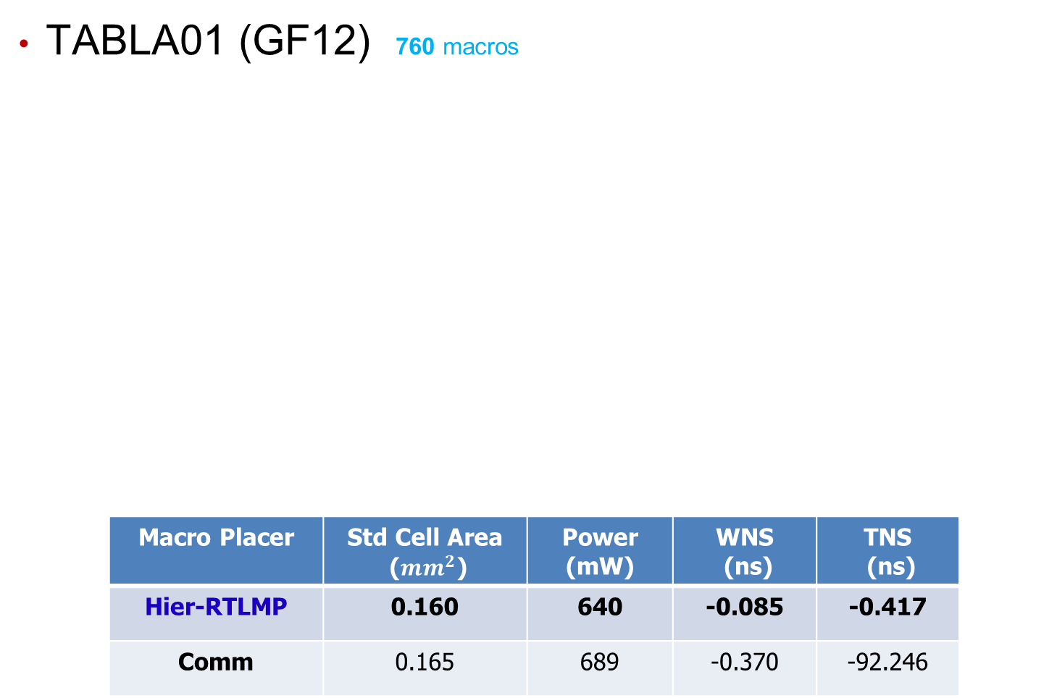
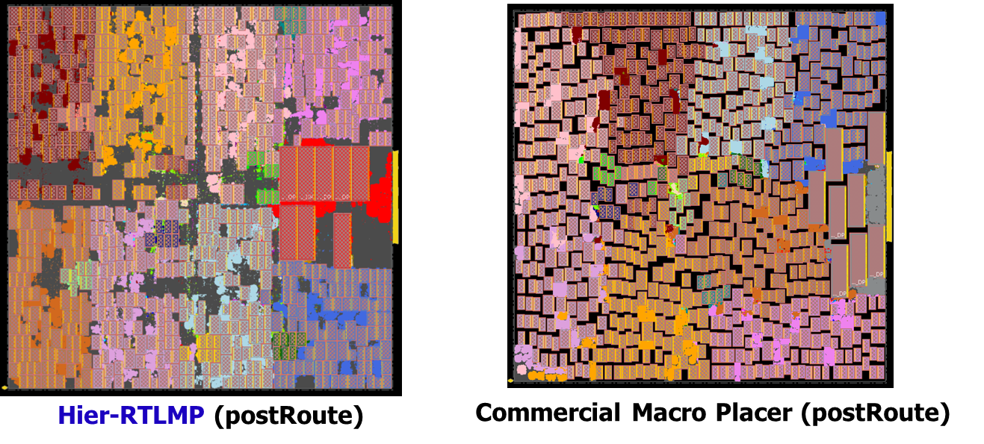
Hier-RTLMP vs. Commercial Macro Placer
Notes:
Actually, for this testcase, Hier-RTLMP dominates a commercial tool’s macro placer – see the area, power and timing results in BOLD – when evaluated apples-to-apples by completing P&R with Innovus.

Slide 27
Direction: Early Design Space Exploration
Can we better explore architecture and SoC floorplan design spaces?
Hier-RTLMP: /src/mpl2
RTL and dataflow-driven, human expert-like
TritonPart: /src/par
Timing- and constraint-driven partitioner
Displaces hMETIS, KaHyPar
Notes:
So we think users could AutoTune this new macro placer, use it for early design space exploration, or other possibilities.
[CLICK] Early design exploration also depends on partitioning that understands timing and modern constraints. TritonPart is a very strong partitioner that is also new in OpenROAD.

Slide 28
Agenda
What is OpenROAD ?
How did we get here ? (The Journey)
Where are we going ? (The Roadmap)
Tool Development
Notes:
Just as with the journey to today, there are many dimensions to how OpenROAD will go forward. I hope we can talk about the roadmap during or after the conference. At least, let me give you one of these OpenROAD stickers! Anyway, I’ll touch on a few dimensions – the first being tool development.
GUI
ML
Train workforce. Open funnel. Serve the underserved. …

Slide 29
OpenROAD Development
How do we determine our priorities?
Align to recurring issues/requests
Strive for biggest impact to the most users
Ensure project sponsors, funders are getting what they want
Allow enough time, effort for each project to build code to last
How do partners determine our priorities?
Drive tool development
Example: multi-height cell support
Support tool development
Gifts, contracts (for specific enhancements, user support)
Many targets are awaiting resources
Improved timing awareness in GRT
Post-GRT repair ERC and timing
DFT (scan chains and reordering)
CCS
…
Notes:
With so few developers, we look for recurring issues or requests, and try to make the biggest impacts for the most users. Sponsors have priority. And development must maintain high quality – “built to last”.
[CLICK] Our partners also drive development, such as enabling multi-height cell support – and they also directly support engineering effort to make enhancements or dedicated support bandwidth.
[CLICK] And there is a backlog of R&D targets as well.

Slide 30
Synthesis is a Priority
QOR from Yosys + ABC needs to be improved
This has been very consistent feedback
Project focus has been on Netlist to GDS
Looking for some dedicated people to work on this
Current thinking on prioritization
System Verilog support
Reduction of gate count
Timing-driven operator implementation selection
Timing-driven resource sharing
Remapping after placement to improve timing
Notes:
To all the OpenROAD users here: Synthesis is our top priority! We know that quality of results from Yosys plus ABC needs improvement – feedback has been clear on this.
We are looking for dedicated people to hire for synthesis – and we have [CLICK] this guidance from users on where we should prioritize next steps.

Slide 31
Other Current Priorities
CTS usability and QOR
Dedicated developer time now going into CTS
Reduce need for manual parameter tuning
Hierarchical CTS (latency inside large macros)
There are still usability and quality issues with CTS
Preliminary UPF support
Support of multiple power domains = long-standing request
UPF is a rich standard with many features
Starting with support of simple on-off domains
Exploiting more PPA optimization levers
Multi-height cells, multi-bit FFs
Timing and power recovery: Gate cloning, VT swap
Notes:
Other areas of R&D focus include CTS, UPF support, and doing better with more PPA optimization levers. This includes multi-bit flop clustering for clock power reduction, and timing and power recovery using operations such as gate cloning or VT swap.

Slide 32
Agenda
What is OpenROAD ?
How did we get here ? (The Journey)
Where are we going ? (The Roadmap)
Tool Development
Governance and Transition
Notes:
Another dimension of the future is the Governance, Transition and Sustainment of OpenROAD. Again, your thoughts and suggestions are VERY welcome on this topic!
Train workforce. Open funnel. Serve the underserved. …

Slide 33
OpenROAD DARPA Contract Ends 12/31/2023
Sustaining the project and the development team has been top of mind
How would things change if the OpenROAD project ended?
Substantial funding today is from industry gifts, and software development + support contracts
E.g., hardware startups
Some structure is known:
Precision Innovations will continue to develop and support OpenROAD
A new OpenROAD Initiative foundation (non-profit) provides a path for philanthropic support
Notes:
So, our DARPA support ends in around 117 days. How to sustain OpenROAD development and support has been a major focus for well over a year.
[CLICK] PII has received considerable support beyond DARPA funds for aspects of OpenROAD development. Hopefully this will increase going forward.
[CLICK] Right now, it is known that PII will continue to develop OpenROAD, and a new nonprofit foundation provides a path to philanthropic funding.

Slide 34
Precision Innovations, Inc. Overview
Company/Team Overview
Technology Overview
Principal industrial developer and integrator of the OpenROAD RTL to GDS ASIC/SoC Development solution
Founded 2019
Electronic Design Automation (EDA) veterans – 10 employees / contractors
HQ – San Diego, CA.
OpenROAD is an EDA solution for hardware implementation of ASIC and SoC chips
Proven (600+ tapeouts), open source, physical design solution.
Used on designs down to 12nm
Core competency: RTL to GDS EDA flows leveraging AI/ML for design space exploration and automated design implementation
AI based Autotuner to maximize results
Fast estimation / new design feasibility analysis
Professional Support Solutions available.
History
DARPA award for OpenROAD
Key customers – Google and Intel
Partners - Siemens and GlobalFoundries
Notes:
Precision Innovations was founded in 2019 to bring EDA veteran talent into OpenROAD. The company is based in San Diego and has three revenue streams: (1) OpenROAD development as a subawardee on the DARPA contract; (2) OpenROAD development outside of the DARPA award; and (3) OpenROAD support contracts with OpenROAD users who need high support bandwidth or agile enhancements to the tool. PII is now at 10 employees and contractors.

Slide 35
The OpenROAD Initiative 501(c)(3) Nonprofit
What is The OpenROAD Initiative www.openroadinitiative.org
A 501(c)(3) public charity for the benefit of open source EDA and related technology
Founded in February 2023 by Tom Spyrou
Vision: Foster open-source chip design, EDA projects, and programs that lower costs, democratize access to tools, provide training and accelerate innovation for the semiconductor industry
Goals
Continued development of OpenROAD and all open-source EDA
Development of open source PDKs both manufacturable and Proxy
Creation of education material teaching chip design
Training of new EDA developers via a high quality software system
Who would contribute
Any person or organization interested in the continued development of the open design ecosystem
Notes:
Because a considerable amount of OpenROAD support from companies comes in the form of gifts, we want to make sure that such funding can be applied in whatever way is best for the project. So, a nonprofit foundation called the OpenROAD Initiative has been set up for this purpose. The vision is to broadly foster open-source chip design, EDA projects, and the democratization of tool access and training to accelerate semiconductor-based innovation. Specific goals [CLICK] encompass open-source EDA beyond OpenROAD (Surelog, KLayout, Yosys), as well as proxy design enablements, education and training are aligned with this vision. and everyone is welcome to contribute. And REALLY: *EVERYONE* can contribute – documentation, a test, code, data … A 17-year old is now working on multi-bit flip-flop clustering. A visiting student from Korea has built
[3236 words]

Slide 36
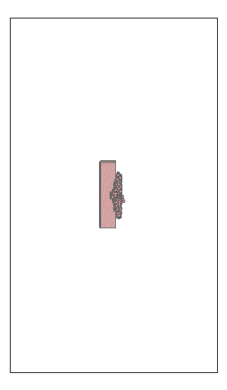
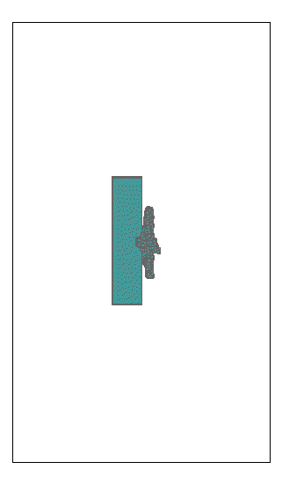
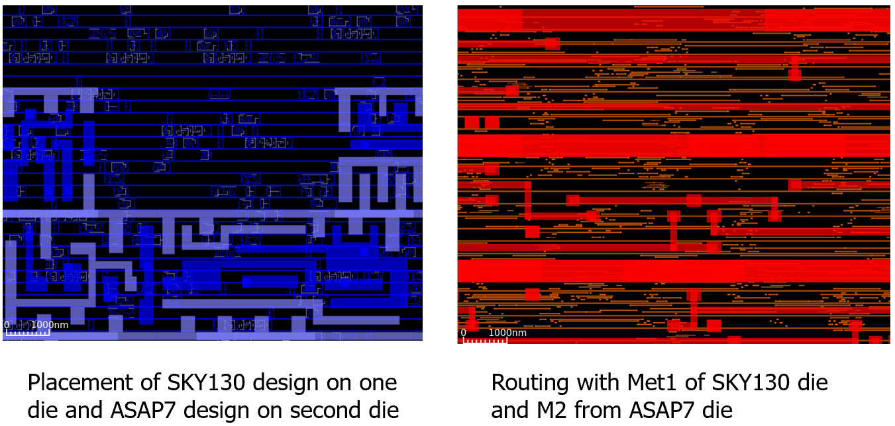
Agile Development on OpenROAD: Example
Top Die
Bottom Die
Both
ICCAD-2023 Contest testcase, 32 macros and 740K stdcells
DB/GUI enhancements: 2-tier P&R views
Notes:
… a 3D version of our global placer, leveraging our latest partitioners – here is an instance with 32 macros and 740K cells. Matt Liberty has supported this with DB extensions and [CLICK] new GUI views of the stacked tiers.

Slide 37
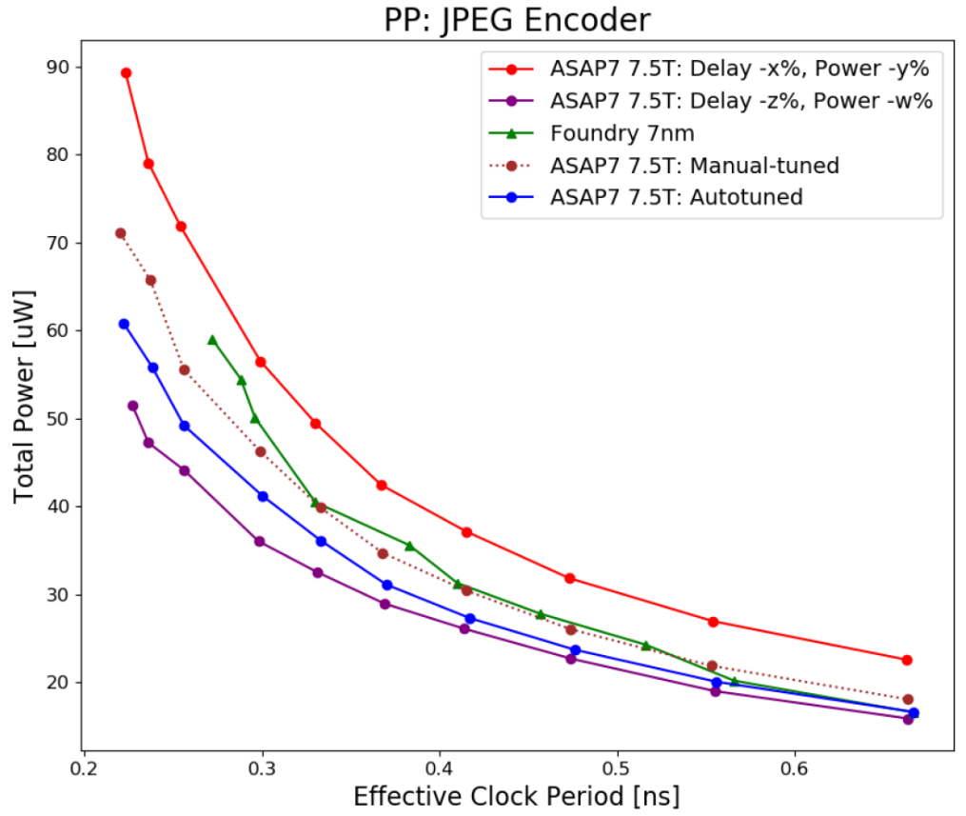
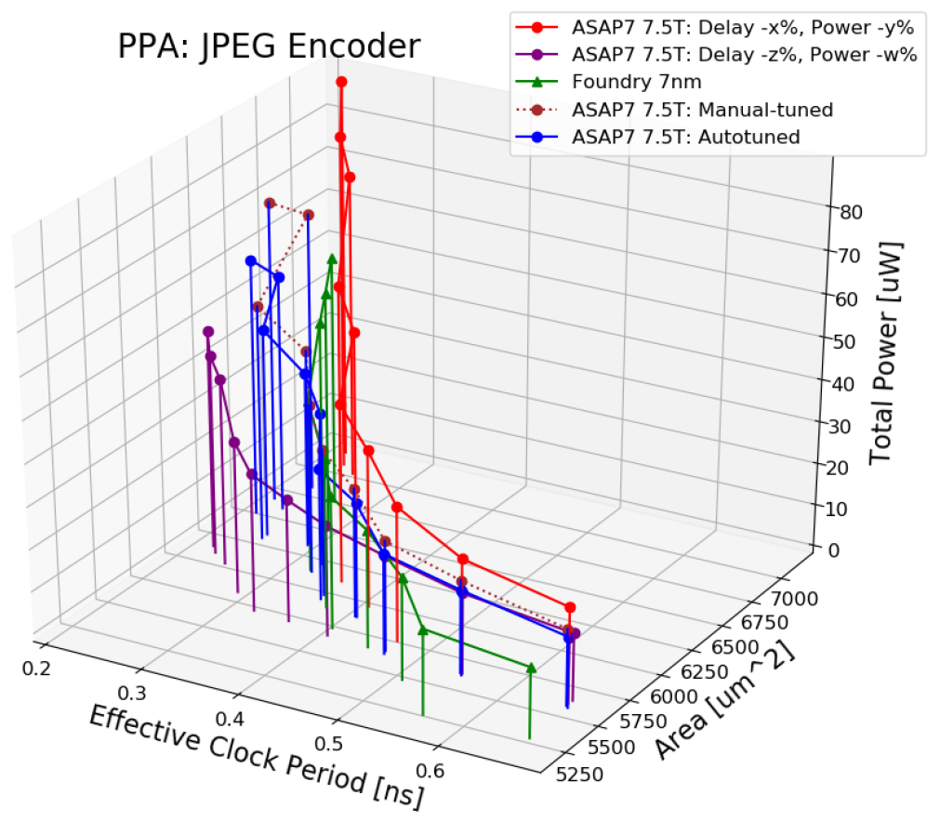
Building Out Proxies: Example
Scaled ASAP7 PDK and enablement can be used to bound power and performance of foundry 7nm
Area scaling can match foundry 7nm outcomes
Autotuning of scaling factors has been implemented
Notes:
Another student is figuring out how to scale the ASAP7 open-source PDK to match PPA outcomes from foundry 7 nanometer enablement. The foundry 7 nanometer PPA surface for JPEG encoder is in GREEN. We can easily box it in – even with autotuning of scale factors – our goal is for designers to know what they’ll see in commercial 7 nanometer based on some number of trial runs with OpenROAD on scaled ASAP7.

Slide 38
Agenda
What is OpenROAD ?
How did we get here ? (The Journey)
Where are we going ? (The Roadmap)
Tool Development
Governance and Transition
ML Enablement for OpenROAD
Notes:
A third dimension, which I really have to mention, is ML enablement.
Here’s where OpenROAD has a huge advantage – because with commercial EDA you can’t share data or models, you can’t upload anything into ChatGPT, and so on – you’re “stuck” in those copyrighted, can’t measure-or-model silos.

Slide 39
What Exists Today in OpenROAD?
OpenROAD: Open-source EDA enabling AI for EDA
What do designers/users work with?
What can they also
work with?
Verilog
+ libraries, constraints
OpenROAD
Enables an ML for EDA playground
Verilog
+ libraries, constraints
RTL to GDS flow:
RTL to GDS flow:
Logic Synthesis
Logic Synthesis
Floorplanning
Floorplanning
Placement
Placement
Python Interface/interpreter
Timing and RC extraction
TCL interface for users
TCL interface for users
Clock Tree Synthesis
Timing and RC extraction
Clock Tree Synthesis
Global and Detailed Routing
Global and Detailed Routing
GDSII final layout
Layout Finishing
GDSII final layout
Layout Finishing
Thanks to: Prof. Vidya Chhabria, ASU
Notes:
So, these slides are from Professor Vidya Chhabria at ASU, who has worked with OpenROAD from the beginning and who is a close collaborator with NVIDIA on ML EDA. Vidya and her student are currently working on pythonization and ML-directed APIs in OpenROAD.
What everyone is familiar with is OpenROAD’s TCL interface. But OpenROAD also has [CLICK] a Python interpreter. The interpreter can run all the engines within OpenROAD except OpenSTA, as of today. So, it opens doors to users who are unfamiliar with TCL (basically, the large software community) – and it also enables a playground for ML and chip design enthusiasts who would like to explore the potential of ML algorithms in physical design.

Slide 40
Vision: OpenROAD as an ML for EDA Playground
OpenROAD
Enables an ML for EDA playground
Verilog
+ libraries, constraints
RTL to GDS flow:
Logic Synthesis
User friendly data formats
Standard ML-friendly data representation formats
Python APIs on existing EDA tools
Enable data generation in ML-friendly format
Callbacks and EDA database writebacks from the ML environment
Node and edge transformation to automatic EDA tool python API translation for novice EDA tool users
Floorplanning
Placement
Python Interface/interpreter
Timing and RC extraction
TCL interface for users
Clock Tree Synthesis
Global and Detailed Routing
GDSII final layout
Layout Finishing
Thanks to: Prof. Vidya Chhabria, ASU
Notes:
The vision is for OpenROAD to serve as a playground for EDA researchers and the chip design community, where ML/RL algorithms integrate seamlessly and we can explore the potential of ML both within and around traditional EDA algorithms.
While some of the python APIs exist, an ML for EDA playground requires three things: (1) data representations/formats for LEF/DEF/Verilog that integrate with ML libraries; (2) additional python APIs that return information from the database in formats ML algorithms can interpret; and (3) APIs that can have callbacks from ML predictions back to the database. For example, graph-based ML algorithms that perform node and edge transformations can map back to updates to the netlist and database. What might these data formats and APIs look like?

Slide 41
ML for EDA Playground: CircuitOps Data Format
ML-friendly data
representation format
Intermediate representation of EDA data as labeled property graphs (LPG) represented as deep graph library (DGL) object or graph tool which integrates easily with PyTorch
Each node has associated relational tables that store node features, e.g., pin slack, transition, etc.
Thanks to: Prof. Vidya Chhabria, ASU
Notes:
For one example: OpenROAD is currently working on supporting CircuitsOps format, which was proposed by the NVIDIA research group led by Mark Ren. There will be an ICCAD23 special session paper on this. The format is a graph-based representation of the netlist where every edge, pin, or cell is a node in the graph with edges that connect them. Each node has annotated tables with a variety of properties (like transitions, slacks, logic functions). Having data in the form of graphs (DGL/graph tool) and tables allows easy application of GNN/GCN based algorithms, easy query of node features, and batch parallel processing with PyTorch.

Slide 42
ML for EDA Playground: ML-centric APIs
1) all_slacks = ord.get_property(list_pins, “rise_slack”)
where all_slacks is a numpy array.
2) graph_design = ord.get_netlist(list_insts, properties)
where graph_design is a DGL graph object where all nodes are instances in list_insts annotated with properties as node/edge features.
3) cong_map = ord.get_map(map=congestion, resolution=1um)
where cong_map is a 2D numpy array representing a heat map.
Examples of image-based ML data extraction
Congestion
DRC violations
Examples of graph-based data extraction:
node, edge features
IR drop
Thanks to: Prof. Vidya Chhabria, ASU
Notes:
This slide shows example ML-centric APIs that will make the ML for EDA playground easy to “play” in. For instance, in the ML world there are three kinds of algorithms applied to EDA problems: graph-based, image-based, and RL-based algorithms. The APIs developed will support these algorithms and examples are shown on the slide. For instance, APIs that return the CircuitsOps graph, APIs that return congestion maps/IR drop maps as numpy arrays, and APIs that can translate transformations in the ML world back to OpenDB.

Slide 43
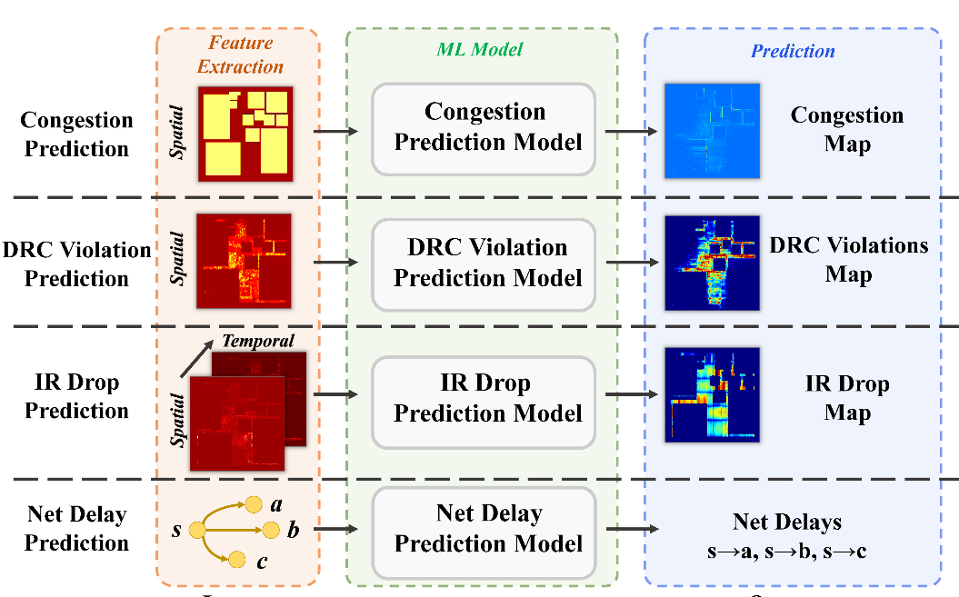
ML for EDA Playground: Example Optimization and Analysis
ML-based optimization by training RL agents within OpenROAD
ML-based analysis for OpenROAD algorithm optimization
OpenROAD CircuitOps graph database
ML built within OpenROAD interpreter
Open ROAD database
ML model existing within OpenROAD interpreter
Inference
Thanks to: Prof. Vidya Chhabria, ASU
Notes:
The playground, once built, will allow ML-based optimization (RL-based placement/sizing) by allowing RL agents to be trained within OpenROAD and traditional optimization with ML-based predictions within OpenROAD. With current TCL based commercial EDA tools this is nearly impossible without reinventing the wheel (basically: developing the underlying algorithms in Python).
[3887 words]

Slide 44
ChatEDA: Autonomous EDA Agent Empowered by LLM
Conversational interface for human-toolflow interaction
→ improved productivity
#1. User Requirement
For the design named “aes” on the platform “asap7”, please perform synthesis with a clock period of 5, followed by floorplan with a core utilization of 70%. Then, execute placement with a density of 0.8. Next, proceed with CTS to fix 40% of violating paths. Finally, evaluate the performance after routing using “power” metric.
Workflow
(user) natural language input
(ChatEDA) task planning
(ChatEDA) script generation
(OpenROAD) task execution
Thanks to: Prof. Bei Yu, CUHK – see https://arxiv.org/pdf/2308.10204.pdf
Notes:
So I have a bonus – this paper from Professor Bei Yu at CUHK was presented on Monday at the MLCAD Workshop. It develops a conversational interface for human-to-toolflow interaction, and the paper presents five example tasks that have been validated with production of working OpenROAD Tcl scripts.
Note that the research involving ChatGPT4, and the paper itself, probably couldn’t have been done with, say, a FusionCompiler.

Slide 45
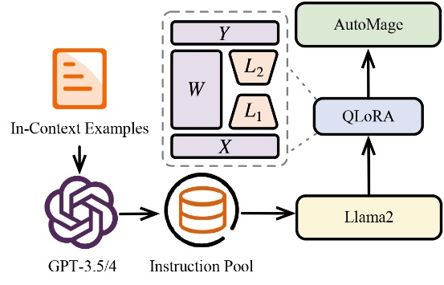
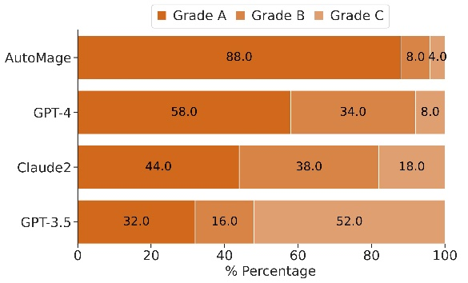
LLM with EDA Domain Knowledge
ChatEDA is based on an LLM + fine-tuning with EDA domain knowledge
→ outperforms GPT-4 in various domain-specific tasks
For more details, please refer to the MLCAD’23 paper (arXiv: 2308.10204) or contact byu@cse.cuhk.edu.hk
Thanks to: Prof. Bei Yu, CUHK
Notes:
ChatEDA based on Llama2 can outperform GPT-4 after fine-tuning with domain knowledge – the paper has the details. We can expect many more works coming in the next year or two – and they will have to use a platform like OpenROAD…

Slide 46
Agenda
What is OpenROAD ?
How did we get here ? (The Journey)
Where are we going ? (The Roadmap)
Tool Development
Governance and Transition
ML Enablement for OpenROAD
Background Thoughts
Notes:
Finally, I have a few “background thoughts” to guide the roadmap of OpenROAD and other open-source EDA efforts…
Due to time, I’ll just leave the slides in the deck. Basically, there are three messages. First, understand the bar to success and impact. Second, infrastructure is at the end of the day a commodity – we just need ONE version (like an open-source timer) that works. We don’t need five timers that don’t work. So, “more wood behind fewer arrows”. And third, because there is always data that can’t be shared, we need to work together on proxies.

Slide 47
Background Thought #1: Bars Matter
Is it good enough?
Relevance (functionality, data, quality of results)
Foundry N5 vs. ASAP7 / ASAP5
Commercial SP&R (PPAC) vs. academic/open-source SP&R
Commercial product designs vs. open hardware designs
Quality, continuous improvement
Support
Can I rely on it?
Ph.D. students vs. design/EDA professionals
Documented, maintained, supported
User community
Availability, terms and conditions
“more wood behind fewer arrows” ?
Notes:
Background Thought Number One: Bars Matter. A lot.
“Is it good enough?” How relevant is it in terms of functionality, data produced, quality of results and so on? Whatever the answer, is it measurably and continuously improving? Is it actively supported? These are aspects of “good enough”.
[CLICK] And, can I rely on it? Student code versus professional code. Training and documentation, user community, availability – with what terms and conditions. These “Bars” questions – relevance and quality in particular – are always aimed at ACADEMIC and open-source EDA. [CLICK] So, do we need more wood behind fewer arrows?

Slide 48
Background Thought #2: Infrax = Commodity
Claim: Infrastructure is not differentiating
This means Pick one, move on
For (digital) IC EDA and design:
Data model, DB, incremental STA, readers/writers, standards support, PDK support, logging, scripting, parallelization, GUI … should be like plumbing and utilities
“Don’t need to think about these” is also a Bar !
See:
OpenDB
METRICS2.1
OpenROAD
…
“more wood behind fewer arrows” !
Notes:
Thought Number Two: If it’s infrastructure, it’s a commodity.
INFRASTRUCTURE IS NOT DIFFERENTIATING. IT JUST NEEDS TO EXIST. Should highway signs be green or blue. Should stoplights be vertical or horizontal. PICK ONE AND MOVE ON.
[CLICK] I am convinced that data model, DB, STA, readers and writers, PDK support, loggers, extension language support, GUI – should be like plumbing and utilities – if they work, you don’t think about them. Which is also a BAR.
[CLICK] METRICS2.1 or OpenDB or OpenROAD or whatever – we need the elements of a roadbed upon which we build a road ahead --- for instance, for research on machine learning in EDA which has to include open data and explainable models and optimization benchmarking. We don’t need five roadbeds – but we need at least one.
Standards, interoperability, efficiency, frameworks are everywhere the history of EDA and IC design. Without them, there is just fragmentation of resources, and Towers of Babel, which are BAD.
[CLICK] So it really IS a matter of “Put more wood behind fewer arrows!”

Slide 49
Background Thought #3: Don’t Ignore Proxies!
What else blocks adoption of open-source EDA?
Validations (of relevance)
Root-cause blocker: “not sharable”
Ex: foundry N5 PDKs, enablements are not sharable
grow ASAP7 / ASAP5 PDKs, enablements into research proxies
Ex: commercial EDA SP&R tools/IP are not sharable
can grow OpenROAD, etc. into research proxies
Ex: commercial IPs are not sharable
can grow NVDLA, OpenPiton, Chipyard, etc. into research proxies
Improve proxies to unblock ourselves !
“A journey of a thousand miles begins with a single step”
Notes:
And Thought Number Three: We shouldn’t forget that Good Proxies are essential to the development and adoption of open-source EDA.
Open-source EDA is often rejected because there is poor validation or confirmation of relevance. And the root cause of this:
[CLICK] Something, Somewhere, was NOT SHARABLE.
[CLICK] NOT sharable implies the need for high-quality, open PROXIES. Proxy PDKs and enablements, Proxy EDA tools that we can benchmark and record data from. Relevant Proxy testcases and design drivers.
If proxies aren’t good enough today, [CLICK] it blocks the entire community – and the community needs to invest efforts accordingly.
[CLICK] It may be a journey, but there’s a saying for that.

Slide 50
Agenda
What is OpenROAD ?
How did we get here ? (The Journey)
Where are we going ? (The Roadmap)
Tool Development
Governance and Transition
ML Enablement for OpenROAD
Background Thoughts
Summary
Notes:
So, to summarize …

Slide 51
Summary
OpenROAD is now in its 6th year
“Going viral” in many dimensions: community, education and workforce development, commercial use
December 31, 2023: formal end of the DARPA project
Precision Innovations, Inc is the core R&D organization
OpenROAD Initiative 501(c)(3) foundation for philanthropic support
Thank You: On behalf of the entire project, heartfelt thanks to so many of you in the audience for support, feedback, and trust in OpenROAD and its mission
Let’s continue the journey !
Notes:
OpenROAD has turned the corner on a number of dimensions, and is on its way to greater commercial use at richer sets of foundry nodes.
The project ends this year, and PII’s commercial contracts as well as a nonprofit foundation are part of how OpenROAD will be hoping to sustain itself.
[CLICK] On behalf of a really great team, I would like to offer you heartfelt thanks for support, feedback, and trust in OpenROAD and its mission.
[CLICK] I hope that we can continue the journey, together !

Slide 52
Some Links (talks are always posted at vlsicad.ucsd.edu)
“Leveling Up: A Trajectory of OpenROAD, TILOS and Beyond”, Proc. ISPD, March 2022. .pdf .pptx
“Our Real Scaling Challenge: People”, ACCESS-CEDA seminar, Sept. 2022. .pptx
“Bars and Barriers to Overcome for Shared ML EDA Infrastructure”, NSF Workshop on Shared Infrastructure for Machine Learning EDA, March 2023. .pptx
Thoughts on open source in EDA
2002: “Toward CAD-IP Reuse: The MARCO GSRC Bookshelf of Fundamental CAD Algorithms” [.pdf] (also: [.pdf])
2019: “Looking Into the Mirror of Open Source” [.pdf]
2020: “Open-Source EDA: If We Build It, Who Will Come?” [.pdf]
2021: “The OpenROAD Project: Unleashing Hardware Innovation” [.pdf]
2022: “The OpenROAD Project: A Foundation for Research and Education in EDA and IC Design” [.pptx]
2022: “A Mixed Open-Source and Proprietary EDA Commons for Education and Prototyping”, [.pdf] [.pptx]
2023: Talk on OpenROAD at the 3rd Open-Source Design Automation Workshop (OSDA-2023) [.pptx]
“https://theopenroadproject.org and https://github.com/The-OpenROAD-Project
Notes:
Here’s my usual Links slide, and I look forward to our conversations here and beyond !

Slide 53
THANK YOU !
Notes:
Thank you very much!

Slide 54
BACKUP: GUI

Slide 55
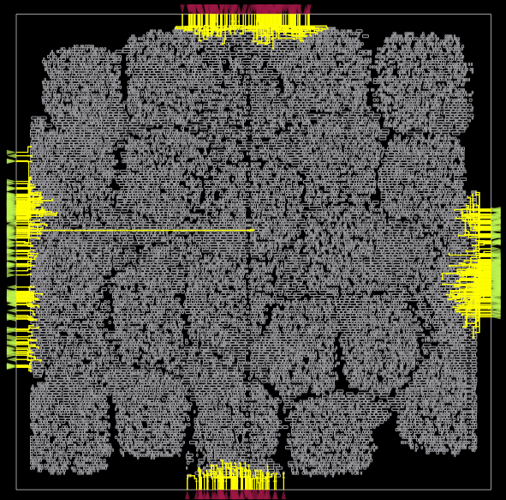
GUI: Select command usage to find all IO nets
select -type Net -filter BTerms=CONNECTED
Notes:
The OR gui has a powerful filter option now. This allows you to select objects by any property seen in the inspector.
The new select command example to find all IO nets by finding all Net that have a non-empty set of BTerms:

Slide 56
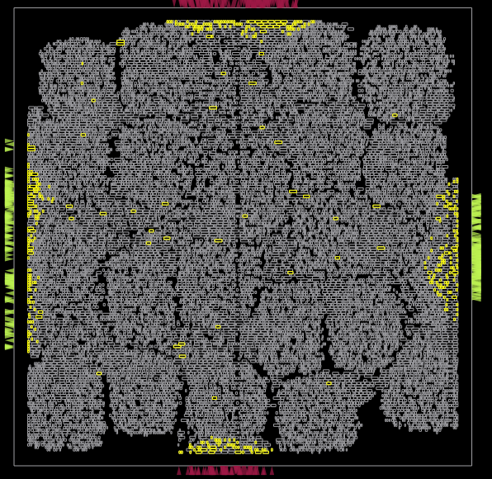
Find instances related to timing optimization
select -type Inst -filter "Source type=TIMING"
Notes:
Another example of filtering is finding all instances related to timing optimization:

Slide 57
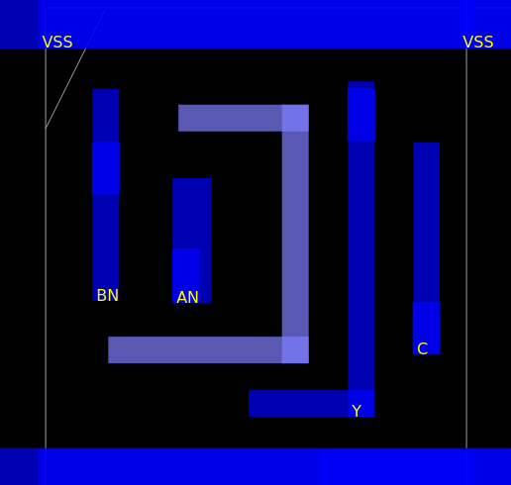
Pin Labels
Notes:
Many small usability enhancements have been made recently. A user-contributed example is the ability to show pin labels. Such tasks are an easy entry into OR development. In GitHub such issues are labeled as ‘good first issue’.

Slide 58
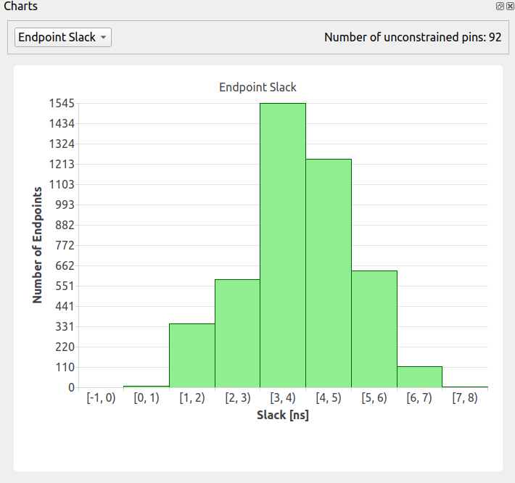
Slack Histogram
Notes:
The slack histogram is a classic display of design QOR. The slack at each timing endpoint is displayed as a histogram. OpenROAD can generate and display this at any point in the design process.

Slide 59
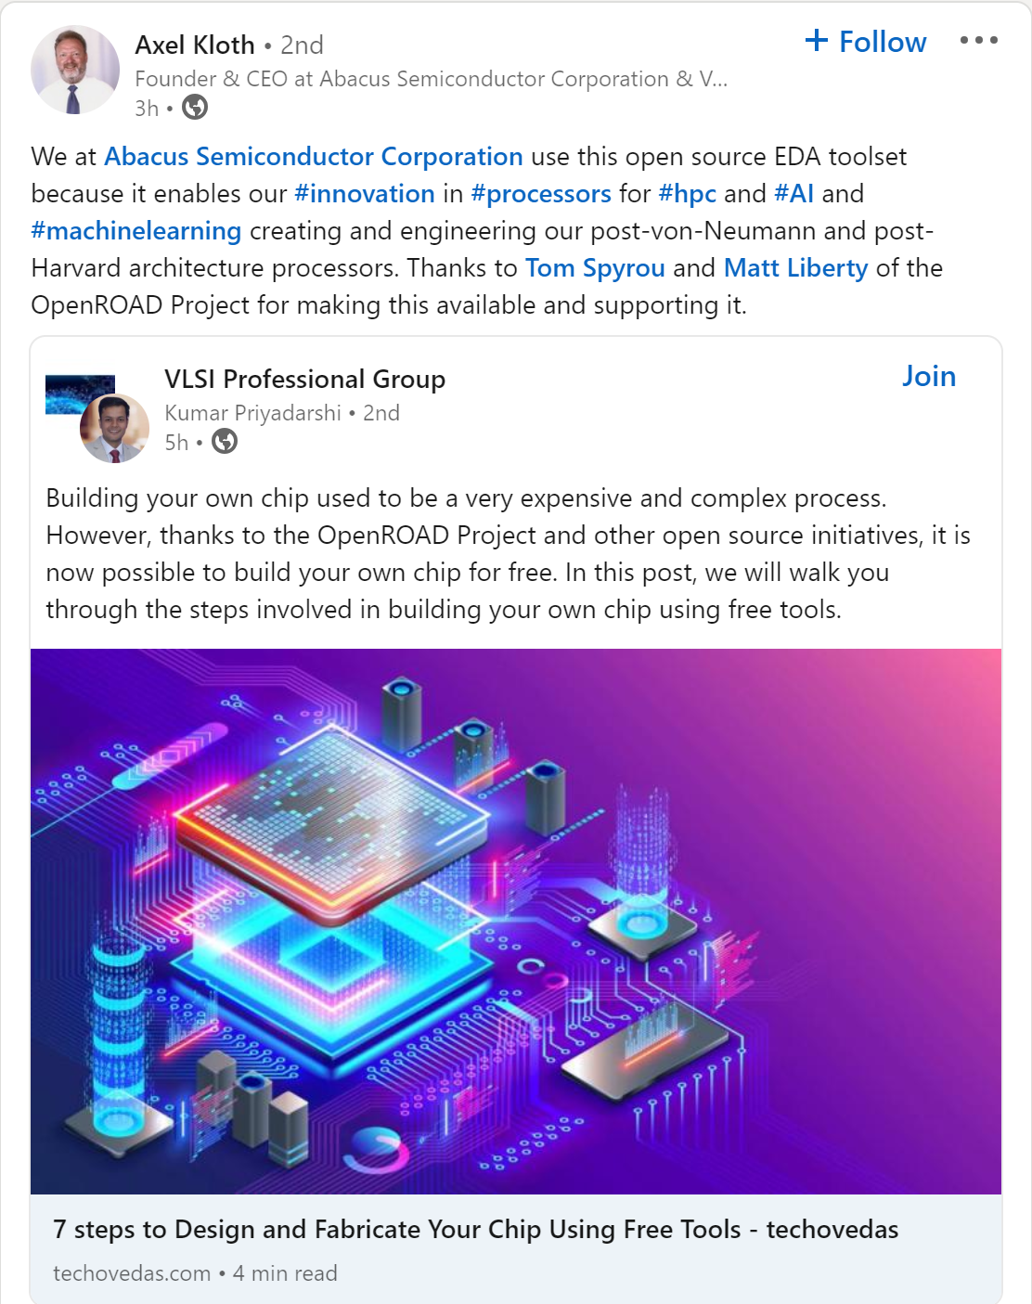
This Past Tuesday
Notes:
I showed some news from MLCAD-2023 earlier this week. Just this past Tuesday there was this on LinkedIn, I think … again: turning the corner …

